Slide 1

TAILTIU TEACHER DEVELOPMENT
BEYOND THE
COURSEBOOK
The REAL Loop for AI-Assisted
Authentic Materials
One real-world source. One purposeful task. Less planning.
https://teacherdevelopment.tailtiu.org/
https://learningenglish.tailtiu.org/
https://tailtiu.org/
Notes:
Timing: 0:00-0:30
Presenter notes:
Welcome participants and state the practical promise: this is a short teacher-development session about occasionally opening the course onto learners' real worlds, without creating an unsustainable planning burden. Make clear that the session is not an argument against coursebooks.
[Sources]
- Tailtiu logo supplied by Martin Quinn.
- Cover visual generated for this Tailtiu teacher-development deck.

Slide 2
TAILTIU TEACHER DEVELOPMENT
Leave with one repeatable planning routine
One authentic source.
One purposeful learner response.
One REAL loop.
By the end, you will be able to turn a short real-world source into a usable classroom activity—without automatically rewriting it.
AI drafts. The teacher decides.
teacherdevelopment.tailtiu.org
2
Notes:
Timing: 0:30-1:00
Presenter notes:
State the outcome explicitly. Participants are not expected to master every possible AI tool. They should leave with a planning sequence they can repeat using a suitable model and their own professional judgement.
[Sources]
- Martin Quinn, 'Beyond Coursebooks; Using Authentic Materials to Keep Motivation up.'

Slide 3
TAILTIU TEACHER DEVELOPMENT
Start with the class whose motivation dips
Think of one class whose motivation periodically drops.
What do those learners care about outside English?
Interests • social worlds • future needs • real-life skills
Discuss with someone near you — 45 seconds
teacherdevelopment.tailtiu.org
3
Notes:
Timing: 1:00-3:00
Presenter notes:
Give participants approximately 45 seconds in pairs. Invite no more than two examples. Use their answers to establish that relevance is class-specific: a source that works brilliantly for one group can fail with another.
[Sources]
- Martin Quinn, Trinity DipTESOL IRP, introduction and findings on relevance, learner interests and motivational dips.

Slide 4
TAILTIU TEACHER DEVELOPMENT
Relevance and variety dominated teachers' choices
Questionnaire: 16 teachers • Follow-up interviews: 3
What it suggests
Teachers selected connection to the group, variety and everyday usefulness more often than direct exam support.
A small, context-specific study of teacher perceptions—not proof that authentic materials cause higher motivation.
Participants could select more than one reason.
teacherdevelopment.tailtiu.org
4
Notes:
Timing: 3:00-5:30
Presenter notes:
Explain the study context briefly: secondary classes between exam years in British Council Spain. Do not overclaim. The figures describe reasons teachers selected, and participants could choose several. The strongest pattern was contextual relevance and breaking monotony, followed by everyday usefulness. Exam support still mattered, but it was not the most frequently selected reason.
[Sources]
- Martin Quinn, Trinity DipTESOL IRP, Question 5 and evaluation. Questionnaire n=16; follow-up interviews n=3.

Slide 5
TAILTIU TEACHER DEVELOPMENT
Authentic material can still produce an inauthentic lesson
REAL-WORLD
SOURCE
PURPOSEFUL
TASK
AUTHENTIC
USE
+
=
Keep the source. Grade the task and the support.
Shorten by omission when necessary—but do not assume that every real-world source needs rewriting.
teacherdevelopment.tailtiu.org
5
Notes:
Timing: 5:30-7:30
Presenter notes:
Define authentic material in one sentence: material not originally designed for language learning. Then make the more important point that authenticity is also affected by the task. A real article reduced to decontextualised grammar hunting can lose its real-world purpose. The teachers in the IRP frequently preserved the source and adapted the task, support or selected section.
[Sources]
- Guariento, W. and Morley, J. (2001), 'Text and task authenticity in the EFL classroom.'
- Buendgens-Kosten, J. (2014), 'Authenticity.'
- Field, J. (1998), 'Skills and strategies: towards a new methodology for listening.'
- Martin Quinn, Trinity DipTESOL IRP, findings on editing, omission and task adaptation.

Slide 6
TAILTIU TEACHER DEVELOPMENT
The barrier is often preparation, not belief
FIND → TRANSCRIBE → ANALYSE → SELECT → DESIGN → CHECK
The teacher knows the learners and validates the result.
AI can accelerate the first pass.
The goal is not more material. It is a faster route to one defensible activity.
teacherdevelopment.tailtiu.org
6
Notes:
Timing: 7:30-8:30
Presenter notes:
Acknowledge the practical objection: authentic materials can create a chain of extra work. AI can help with transcription, initial analysis, brainstorming and drafting. Avoid promising a fixed percentage of time saved. The point is that the teacher moves from blank-page creation to selection and editing.
[Sources]
- Martin Quinn, 'Beyond Coursebooks; Using Authentic Materials to Keep Motivation up.'

Slide 7
TAILTIU TEACHER DEVELOPMENT
The REAL loop keeps the teacher in control
R
E
A
L
RELEVANCE
EVALUATE
ADAPT
LOOK AGAIN
Why this source?
Why these learners?
Why now?
Use AI to surface
possibilities,
barriers and risks.
Adapt the task
and support—not
automatically the source.
Check accuracy,
appropriacy and
classroom value.
The model supplies options. Professional judgement supplies the lesson.
teacherdevelopment.tailtiu.org
7
Notes:
Timing: 8:30-10:30
Presenter notes:
Introduce the four stages without expanding every possible application. Stress that the loop starts and ends with teacher judgement. The middle stages can be assisted by AI, but relevance and final evaluation cannot be delegated responsibly.
[Sources]
- REAL loop developed for this seminar from Martin Quinn's IRP findings and article draft.

Slide 8
TAILTIU TEACHER DEVELOPMENT
R: Relevance comes before language exploitation
WHY THIS?
A recognisable interest, need or real-life skill.
WHY THEM?
The particular learners—not simply the teacher's interests.
WHY NOW?
A useful moment in the course, not a random diversion.
A technically rich source is still the wrong source if the class has no reason to care.
teacherdevelopment.tailtiu.org
8
Notes:
Timing: 10:30-11:30
Presenter notes:
Use the Pink Floyd example from the article if helpful: painstaking preparation cannot rescue a source selected principally from the teacher's own interests. Relevance is not universal; it is relational and time-specific.
[Sources]
- Martin Quinn, Trinity DipTESOL IRP, implications on learner choice and interests.
- Martin Quinn, 'Beyond Coursebooks; Using Authentic Materials to Keep Motivation up.'

Slide 9
TAILTIU TEACHER DEVELOPMENT
E: Ask AI for options before asking for a lesson
ANALYSE FIRST.
DESIGN SECOND.
Analyse this source for [age / level / class].
Identify relevance, barriers, three useful language items, two real-world outcomes and any risks.
Do not rewrite it. Mark anything you cannot confirm.
relevance to this class
likely comprehension barriers
three transferable language items
two possible real-world outcomes
sensitivity, access or copyright risks
Demonstration: EFL Lesson Planner by Oliver Aaron Robertson Jones
The workflow can be used with another suitable, institutionally approved model.
teacherdevelopment.tailtiu.org
9
Notes:
Timing: 11:30-12:30
Presenter notes:
Show the staged prompt. Explain that you want the model to inspect the material before it generates activities. This makes it easier to reject unsuitable language aims and choose one meaningful outcome. Mention the EFL Lesson Planner GPT as a practical example, not as the only acceptable tool. If raw audio or video cannot be processed by the chosen model, provide a checked transcript.
[Sources]
- Martin Quinn, 'Beyond Coursebooks; Using Authentic Materials to Keep Motivation up,' practical AI prompt bank.
- EFL Lesson Planner by Oliver Aaron Robertson Jones, named by the presenter as the demonstration tool.

Slide 10
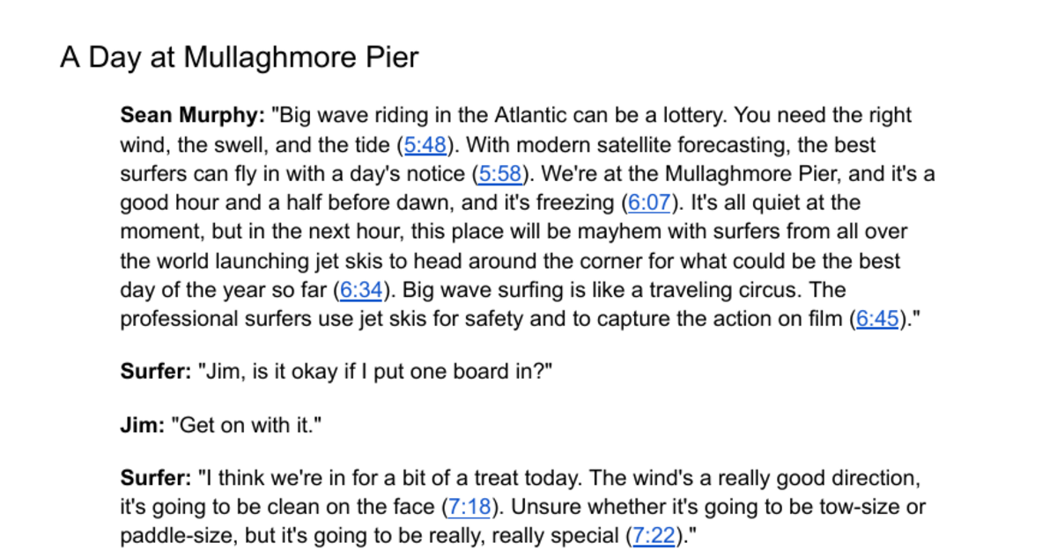
TAILTIU TEACHER DEVELOPMENT
A long documentary becomes a 94-second source
5:48 → 7:22
94 seconds
181 transcript words
politically neutral section
clear documentary purpose
visual support for comprehension
transferable everyday language
PLAY THE EXTRACT
Foreign Correspondent documentary on Irish big-wave surfing
teacherdevelopment.tailtiu.org
10
Notes:
Timing: 12:30-14:30
Presenter notes:
Explain the selection-by-omission process. The chosen section runs from 5:48 to 7:22: 94 seconds and 181 words, excluding labels and timestamps. Play the clip or use the prepared transcript if the connection fails. Ask participants for the overall purpose: surfers are preparing for what could be an exceptional day. Do not describe the conditions as safe; the source does not support that inference.
[Sources]
- Foreign Correspondent documentary: https://www.youtube.com/watch?v=boGMfBjOgqQ
- User-supplied transcript: 'Irish big wave surfing.' Selected section 5:48-7:22.

Slide 11
TAILTIU TEACHER DEVELOPMENT
A: Grade the task with a three-stage sequence
GIST
NOTICE
RECOMMEND
Why are surfers gathering before dawn?
can be a lottery
with a day's notice
be in for a treat
Send a 30-second voice note:
Should a classmate watch the rest?
Gist → Notice → Purposeful response
teacherdevelopment.tailtiu.org
11
Notes:
Timing: 14:30-15:30
Presenter notes:
Demonstrate the compact activity architecture. First viewing: choose the gist. Second viewing: identify evidence and notice three transferable expressions. Final task: recommend the documentary to a classmate in a short voice note. The authentic purpose is recommending online content—something learners genuinely do.
[Sources]
- Worked example developed from the user-supplied Irish big-wave surfing transcript.

Slide 12
TAILTIU TEACHER DEVELOPMENT
L: The teacher catches what the AI cannot know
AI DRAFT
“Why are the surfing conditions safe today?”
TEACHER CHECK
The transcript says the wind is favourable and the waves could be exceptional.
It never says the conditions are safe.
Replace it: “Why could the conditions produce exceptional waves?”
teacherdevelopment.tailtiu.org
12
Notes:
Timing: 15:30-16:30
Presenter notes:
Use this as the clearest demonstration of AI as co-teacher rather than authority. A plausible-sounding question can introduce an unsupported assumption. The teacher checks every answer against the source and changes the question. This is the equivalent of double-marking or peer review.
[Sources]
- Teacher audit based on the selected 5:48-7:22 transcript section.

Slide 13
TAILTIU TEACHER DEVELOPMENT
Your five-minute microdesign
1
Choose the learners and the relevance.
5:00
2
Use AI—or the supplied analysis—to scan the source.
3
Select one genuine learner outcome.
4
Draft one gist task, one noticing task and one response.
Use the surfing source or a short source of your own.
teacherdevelopment.tailtiu.org
13
Notes:
Timing: 16:30-21:30
Presenter notes:
Put participants in pairs. They may use the surfing transcript, a supplied alternative or a source on their device. Ask them to write only a microdesign, not a full lesson plan. Circulate and ask: What will learners genuinely do with this? Give a one-minute warning.
[Sources]
- Participant task based on the REAL loop developed for this seminar.

Slide 14
TAILTIU TEACHER DEVELOPMENT
Would I teach this tomorrow?
✓
Accurate: Every answer is supported by the source.
✓
Accessible: Support helps without removing the challenge.
✓
Appropriate: Age, topic, register and sensitivity fit.
✓
Manageable: Preparation and classroom instructions are realistic.
✓
Purposeful: Learners have a genuine reason to respond.
✓
Worth it: The activity serves this group at this point.
Exchange microdesigns. Recommend one essential change.
teacherdevelopment.tailtiu.org
14
Notes:
Timing: 21:30-23:30
Presenter notes:
Pairs exchange their microdesigns and use the six checks. Ask them to recommend one essential revision rather than rewriting the other pair's activity. If time permits, take one example of a change made after checking.
[Sources]
- Audit criteria synthesised from Martin Quinn's article draft and the REAL loop.

Slide 15
TAKE IT AWAY
One source.
One purpose.
One REAL loop.
Before you leave, name:
ONE CLASS
ONE INTEREST OR NEED
ONE SOURCE TO TRY
AI drafts. Teacher decides.
https://teacherdevelopment.tailtiu.org/
Notes:
Timing: 23:30-25:00
Presenter notes:
Return to the opening promise. Give participants a quiet moment to identify one class, one interest or need, and one possible source. End with the teacher-development address where the slides and supporting materials will be available.
[Sources]
- Closing synthesis developed for this seminar.
- Tailtiu logo supplied by Martin Quinn.

Slide 16
BACKUP SLIDE • NOT TIMED
References and source material
Quinn, M. Teacher decisions on authentic material use for progress in non-exam year Secondary Students. Trinity DipTESOL IRP.
Quinn, M. Beyond Coursebooks; Using Authentic Materials to Keep Motivation up. Draft article.
Guariento, W. & Morley, J. (2001). Text and task authenticity in the EFL classroom. ELT Journal, 55(4), 347-353.
Buendgens-Kosten, J. (2014). Authenticity. ELT Journal, 68(4), 457-459.
Field, J. (1998). Skills and strategies: towards a new methodology for listening. ELT Journal, 52(2), 110-118.
Video and transcript
Foreign Correspondent documentary on Irish big-wave surfing
https://www.youtube.com/watch?v=boGMfBjOgqQ
Slides and teacher materials
https://teacherdevelopment.tailtiu.org/
https://learningenglish.tailtiu.org/
https://tailtiu.org/
The IRP was a small, context-specific study of teacher practices and perceptions. It was not a controlled study of student outcomes.
teacherdevelopment.tailtiu.org
16
Notes:
Timing: Backup / not presented
Presenter notes:
Retain this slide for questions about the evidence base or the worked source. It is not part of the timed 25-minute sequence.
[Sources]
- References listed visibly on the slide.

